Slide 1
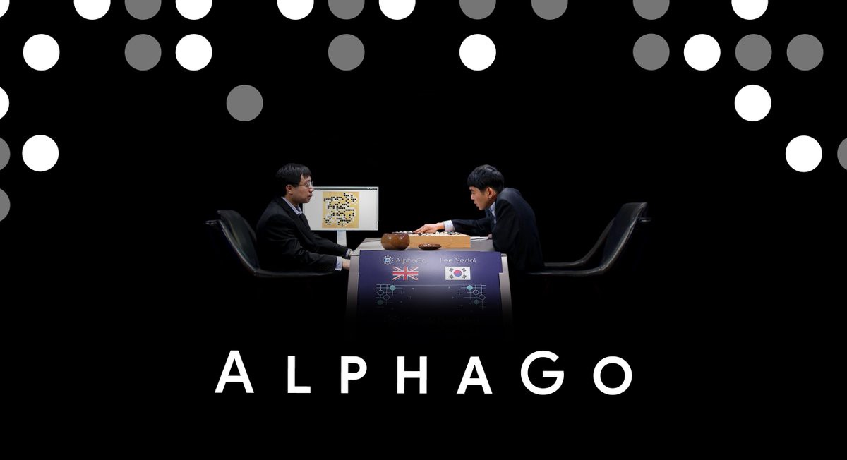
What is AlphaGo? AlphaGo is the first computer program to defeat a professional human Go player, the first to defeat a Go world champion, and is arguably the strongest Go player in history

Slide 2
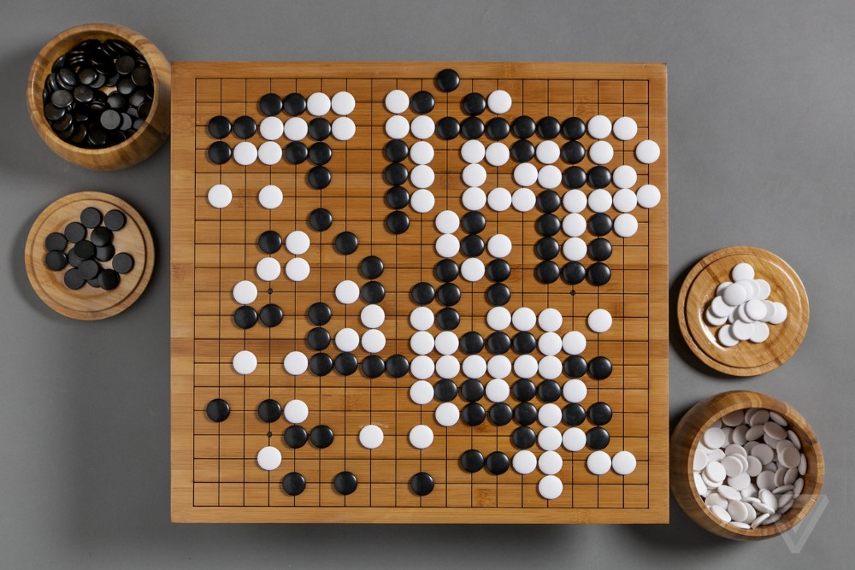
What is Go?
Go originated in China over 3,000 years ago. Winning this board game requires multiple layers of strategic thinking. As simple as the rules may seem, Go is profoundly complex. There are an astonishing 10 to the power of 170 possible board configurations - more than the number of atoms in the known universe. This makes the game of Go a googol times more complex than chess.

Slide 3
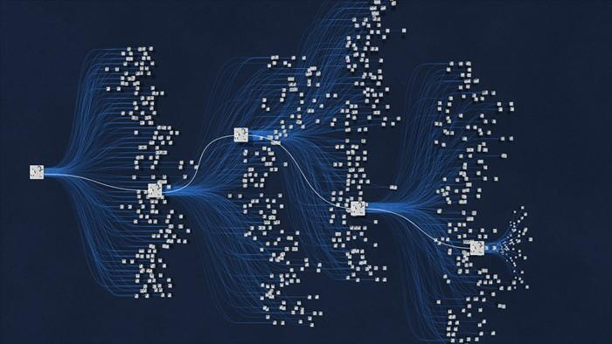
How Does it work?
One neural network, the “policy network”, selects the next move to play. The other neural network, the predicts the winner of the game. “value network”, and Tree Search where is look through different variation of the game and try to figure out what will happen in the future. Over time, AlphaGo improved and became increasingly stronger and better at learning and decision-making through Reinforcement Learning.

Slide 4
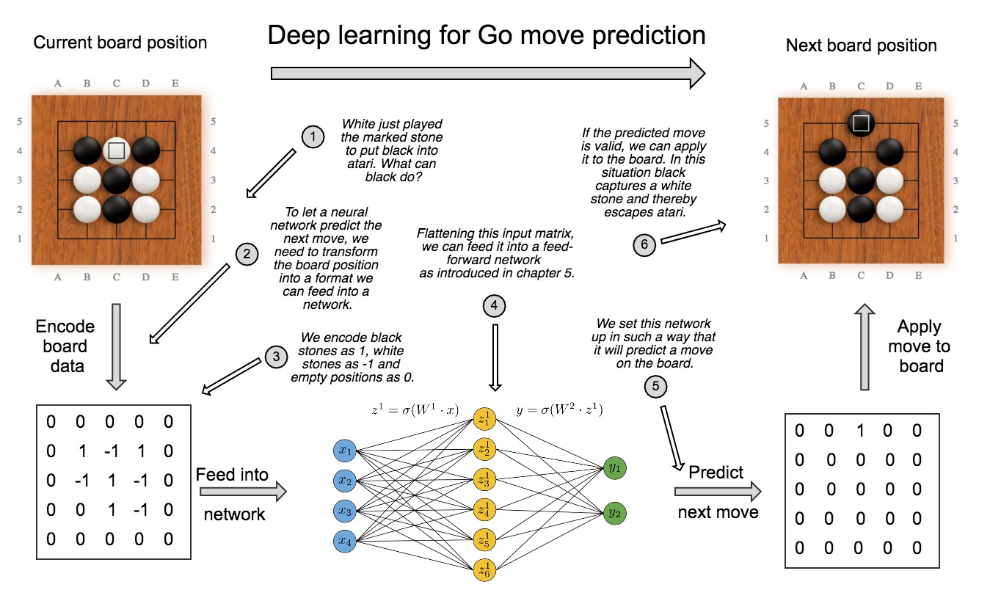

Slide 5
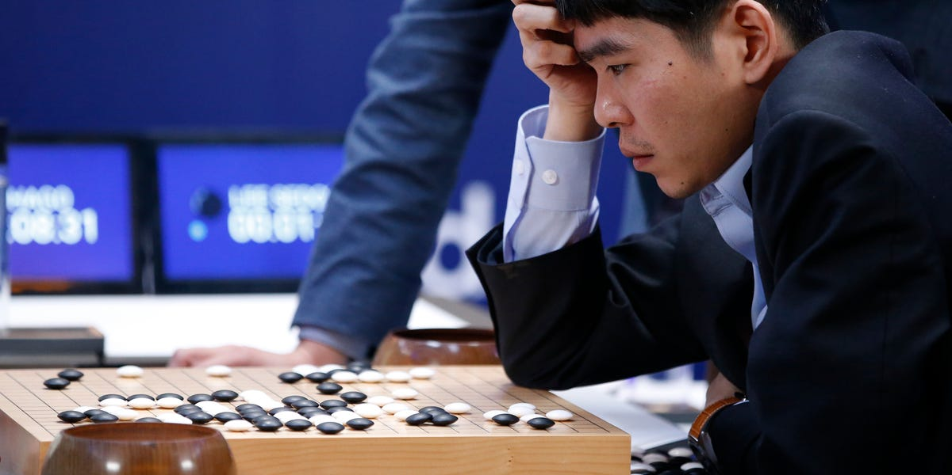
Few Highlights of Game-
Alpha-Go won by 4-1
AlphaGo Move 37 had 1 in 10000 probability
Move 78 Played by LeSedol was known as Gods Move as winning
Chnaces of AlphaGO at that move was 0,007%.

Slide 6
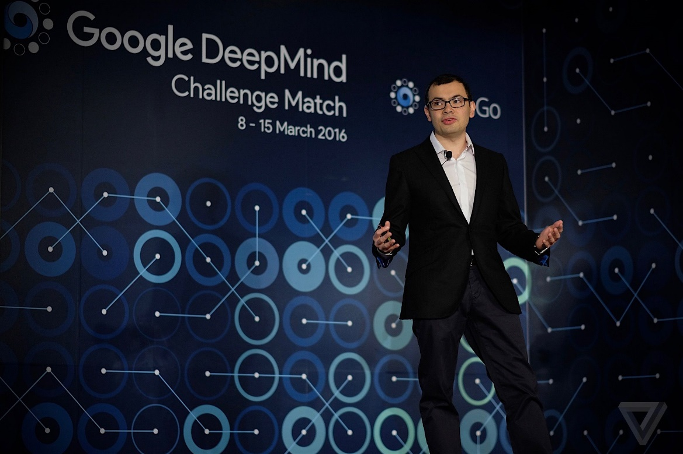
Will you like if Machine will play opposite human ?
Conclusion
It has pushed human creative thinking
It has opened dimensions of new creative move that were beyond human mind
Good human plus machine is best combination
Responsible innovation is the key for ethical ML

